Slide 1
UNIT –1V
TRANSACTION MANAGEMENT
Transaction Processing
Definition
Collection of operations that form a single logical unit of work are called transactions.
Transaction Concept
ATransaction: logical unit of database processing that includes one or more access operations (read -retrieval,write -insert or update, delete).
Transaction boundaries: Begin and End transaction.
An application program may contain several transactions separated by the Begin and End transaction boundaries.

Slide 2
Why Do We Need Transactions?
It’s all about fast query response time and correctness
DBMS is a multi-user systems
  Many different requests
  Some against same data items
Sample Transaction (informal)
Example: Move $40 from current to savings account
To user, appears as one activity
To database:
  Read balance of current account: read( X)
  Read balance of savings account: read (Y)
  Subtract $40 from X
  Add $40 to Y
  Write new value of X back to disk
  Write new value of Y back to disk

Slide 3
Transaction processing system
Transaction processing system :It is a system with large databases and
hundreds of concurrent users that are executing database transactions.
Eg:Reservation,Banking,Stock markets
1.Single-User Versus Multi User Systems
2.Transactions,Read and Write Operations and DBMS Buffers
3.Why Concurrency Control Is Needed
4.Why recovery is needed
Single-User System: At most one user at a time can use the system.
Multi user System: Many users can access the system concurrently.

Slide 4
Concurrent Transactions
B
B
B
B
CPU₂
A
A
CPU₁
A
CPU₁
time
t₁
interleaved processing
t₂
t₁
parallel processing
t₂

Slide 5
Interleaved processing:
concurrent execution of processes is interleaved in a single CPU.
In this example the process A and process B are executing concurrently in an interleaved fashion.
Interleaving keeps CPU busy when a process requires an input or output(I/O) operation,such as reading a block from disk.
The CPU is switched to execute another process rather than remaining idle during I/O time.
Parallel processing: processes are concurrently executed in multiple CPUs.

Slide 6
2.Transactions,Read and Write Operations and DBMS Buffers
A Transaction: logical unit of database processing that includes one or more access operations-these can include insertion,deletion,modification or retrieval operations
Transaction boundaries: Begin and End transaction.
An application program may contain several transactions separated by the Begin and End transaction boundaries
Read only Transaction:If the database operations in a transaction do not update the database but only retrieve data,the transaction is called a read-only transaction.

Slide 7
SIMPLE MODEL OF A DATABASE (for purposes of discussing transactions):
A database - collection of named data items
Granularity – size of a data item.
Basic operations are read and write
read_item(X): Reads a database item named X into a program variable. To simplify our notation, we assume that the program variable is also named X.
write_item(X): Writes the value of program variable X into the database item named X.

Slide 8
READ AND WRITE OPERATIONS:
Basic unit of data transfer from the disk to the computer main memory
is one block.
In general, a data item (what is read or written) will be the field of some record in the database, although it may be a larger unit such as a record or even a whole block.
read_item(X) command includes the following steps:
Find the address of the disk block that contains item X.
2. Copy that disk block into a buffer in main memory (if that disk block is not already in some main memory buffer).
3. Copy item X from the buffer to the program variable named X.

Slide 9
write_item(X) command includes the following steps:
1. Find the address of the disk block that contains item X.
2. Copy that disk block into a buffer in main memory(if that disk block is not already in some main memory buffer).
3. Copy item X from the program variable named X into its correct location in the buffer.
4. Store the updated block from the buffer back to disk (either immediately or at some later point in time)

Slide 10
Sample Transaction (Formal)
T1
read_item(X);
read_item(Y);
X:=X-40;
Y:=Y+40;
write _item(X);
write_item(Y);
t₀
t_{k}
The read-set of T₁ is {X,Y } The write-set of T₁ is also {X,Y }

Slide 11
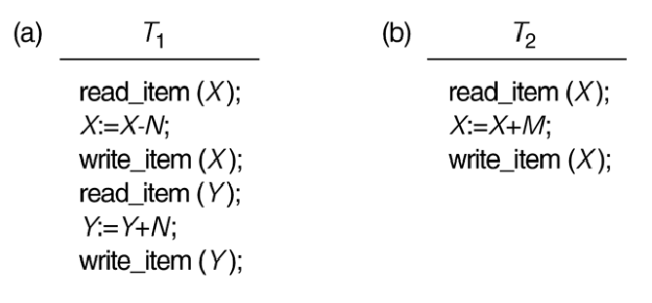
3.WHY CONCURRENCY CONTROL IS NEEDED:
Several problems can occur when concurrent transactions
execute without control
Two sample transactions.
(a) Transaction T1. (b) Transaction T2.
The read-set of T₁ is {X,Y } The write-set of T₁ is also {X,Y }

Slide 12
Consider the Air line reservations database in which a record is stored for each flight.
Each record includes the number of reserved seats for that flight as a named data item,among other information.
Transaction T₁ shows that transfers N reservations from one flight whose no of reserved seats is stored in the data item named X to another flight whose no of reserved seats is stored in the data item named Y
In transaction T₂ reserves M seats on the first flight (X) referenced in transaction T₁
Transaction T₁ and T₂ are specific executions of a program that refer to the specific flights whose no of seats are stored in data items X and Y in the database.

Slide 13
The following problems may encounter if the two transactions
are run concurrently.
1.The Lost Update Problem
2.The Temporary Update (or Dirty Read) problem
3.The Incorrect Summary Problem
The Lost Update Problem
This occurs when two transactions that access the same database items have their operations interleaved in a way that makes the value of some database item incorrect.
Suppose the transaction T₁ and T₂ are submitted at the same time and suppose that their operations are interleaved then the final value of item X is incorrect because T₂ reads the value of X before T₁ changes it in the database and the updated value from T₁ is lost.

Slide 14
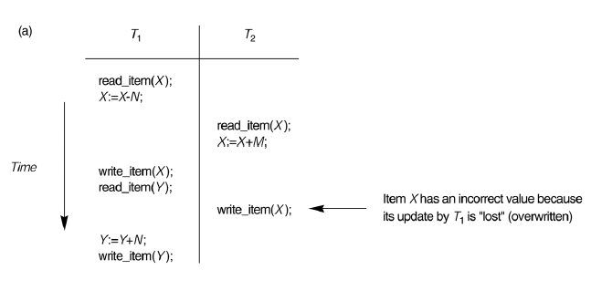
For Eg if X =80 at the start (orginally there were 80 reservations on the flight),N=5 (T₁ transfers 5 seat reservations from the flight corresponding to X to the corresponding to Y) and M=4 (T2 reserves 4 seats on X),the final result should be x=79 but in the interleaving of operations shown ,it is X=84 because the update in T₁ that removed the five seats from X was lost.

Slide 15
The Temporary Update (or Dirty Read) Problem.
This occurs when one transaction updates a database item and then the transaction fails for some reason . The updated item is accessed by another transaction before it is changed back to its original value.
In this eg Transaction T1 fails before completion,so the system must change X back to its orignal value .Before this the transaction T₂ reads
The temporary value of X which is not recorded permanently in the database because of the failure of T_{1.}The value of item X that is read by T₂ is called dirty data,because it has been created by a transaction that has not completed.Therefore this problem is known as dirty read problem.

Slide 16
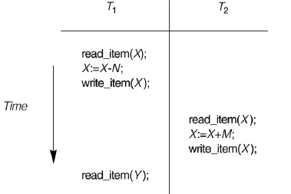

Slide 17
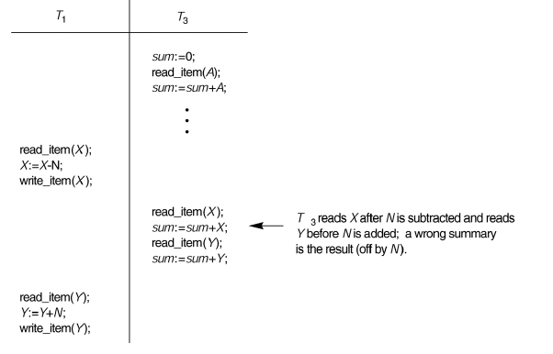
The Incorrect Summary Problem .
If one transaction is calculating an aggregate summary function on a
number of records while other transactions are updating some of these
records, the aggregate function may calculate some values before
they are updated and others after they are updated.

Slide 18
Unrepeatable read
A transaction T reads an item twice and the item is changed by another
Transaction T¹ between two reads.Hence T receives different values for
its two reads of the same item.
4.Why recovery is needed:
Whenever a transaction is submitted to a DBMS for execution,the system
is responsible for making sure that either
i.all the operations in the transaction are completed successfully
and their effect is recorded permanently in the database.
ii.the transaction has no effect whatsoever on the database or on any
other transactions.
The DBMS must not permit some operations of a transaction T to
be applied to the database while other operations of T are not.
This may happen if a transaction fails after executing some operations
but before executing all of them.

Slide 19
Failures are generally classified as
1.transaction 2.system 3. Media failures
Types of failures:
  System crash
  Transaction or system error
  Local errors
  Concurrency control enforcement
  Disk failure
  Physical failures

Slide 20
A computer failure (system crash): A hardware or software error occurs in the computer system during transaction execution. Hardware crashes are usually media failures-for eg main memory failure.
2.A transaction or system error:Some operation in the transaction may cause it to fail, such as integer overflow or division by zero. Transaction failure may also occur because of erroneous parameter values or because of a logical programming error. In addition, the user may interrupt the transaction during its execution.
3. Local errors or exception conditions detected by the transaction:- certain conditions necessitate cancellation of the transaction. For example, data for the transaction may not be found. A condition, such as insufficient account balance in a banking database, may cause a transaction, such as a fund withdrawal from that account, to be canceled.
- a programmed abort in the transaction causes it to fail.

Slide 21
4. Concurrency control enforcement: The concurrency control method may decide to abort the transaction, to be restarted later, because it violates serializability orbecause several transactions are in a state ofdeadlock
5. Disk failure: Some disk blocks may lose their data because of a read or write malfunction or because of a disk read/write head crash. This may happen during a read or a write operation of the transaction.
6. Physical problems and catastrophes: This refers to an endless list of problems that includes power or air-conditioning failure, fire, theft, , overwriting disks or tapes by mistake, and mounting of a wrong tape by the operator.
DBMS has a Recovery Subsystem to protect database against system failures.

Slide 22
Transaction and System Concepts
A transaction is an atomic unit of work that is either completed in its entirety or not done at all. For recovery purposes, the system needs to keep track of when the transaction starts, terminates, and commits or aborts.
Transaction states:
Active state
Partially committed state
Committed state
Failed state
Terminated State

Slide 23
Recovery manager keeps track of the following operations:
begin_transaction: This marks the beginning of transaction execution.
read or write: These specify read or write operations on the database items that are executed as part of a transaction.
end_transaction: This specifies that read and write transaction operations have ended and marks the end limit of transaction execution. At this point it may be necessary to check whether the changes introduced by the transaction can be permanently applied to the database or whether the transaction has to be aborted because it violates concurrency control or for some other reason.

Slide 24
commit_transaction: This signals a successful end of the transaction so that any changes (updates) executed by the transaction can be safely committed to the database and will not be undone.
rollback (or abort): This signals that the transaction has ended unsuccessfully, so that any changes or effects that the transaction may have applied to the database must be undone.
undo: Similar to rollback except that it applies to a single operation rather than to a Whole transaction.
redo: This specifies that certain transaction operations must be redone to ensure that all the operations of a committed transaction have been applied successfully to the database.

Slide 25
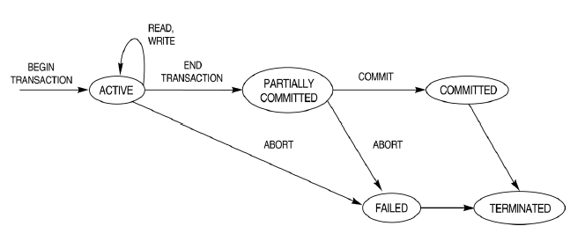
State transition diagram illustrating the states for transaction execution.
A transaction goes into an Active set immediately after it starts execution,where it can issue R/W operations.
When the transaction ends ,it moves to the partially committed state.
At this point some recovery protocols need to ensure that a system failure will not result in an ability to record the changes of the transaction permanently.

Slide 26
Once this check is successful, the transaction is said to be have reached in commit point and enters the committed state.
Once a transaction is commited all the changes must be recorded permanently in the database.
If the check fails or transaction is aborted during its active state,the transaction can go to the failed state. The transaction may then have to be rolled back to undo the effort of its WRITE operations on the database.

Slide 27
System Log
DBMS must assure that we don’t loose information due to system crashes
  i.e., how do we recover from failure?
Keep system log
  Kept on disk, backed up periodically
  Record every action
Types of log record:
[start_transaction, T]
[write_item, T, X, old, new]
[read_item, T, X]
[commit, T]
[abort, T]

Slide 28
The System Log
Log or Journal :
The log keeps track of all transaction operations that affect the values of database items.
This information may be needed to permit recovery from transaction failures. The log is kept on disk, so it is not affected by any type of failure except for disk failure.
In addition, the log is periodically backed up to archival storage (
tape) to guard against such catastrophic failures.

Slide 29
T in the following discussion refers to a unique transaction-id that is generated automatically by the system and is used to identify each transaction
Types of log record:
1. [start_transaction,T]: Records that transaction T has started execution.
2. [write_item,T,X,old_value,new_value]: Records that transaction T has changed the value of database item
X from old_value to new_value.
3. [read_item,T,X]: Records that transaction T has read the value of database item X.
4. [commit,T]: Records that transaction T has completed successfully, and affirms that its effect can be
committed (recorded permanently) to the database.
5. [abort,T]: Records that transaction T has been aborted.

Slide 30
Recovery using log records:
If the system crashes, we can recover to a consistent database state by examining the log and using one of the techniques.
1.Because the log contains a record of every write operation that changes the value of some database item, it is possible to undo the effect of these writeoperations of a transaction T by tracing backward through the log and resetting all items changed by a write operation of T to their old_values.
2. We can also redo the effect of the write operations of a transaction T by tracing forward through the log and setting all items changed by a write operation of T (that did not get done permanently) to their new_values.

Slide 31
Commit Point of a Transaction:
Definition: A transaction T reaches its commit point when all its operations that access the database have been executed successfully and the effect of all the transaction operations on the database has been recorded in the log. Beyond the commit point, the transaction is said to be committed, and its effect is assumed to be permanently recorded in the database.
The transaction then writes an entry [commit,T] into the log.
Roll Back of transactions: Needed for transactions that have a [start_transaction,T] entry into the log but no commit entry [commit,T] into the log)

Slide 32
Redoing transactions: Transactions that have written their commit entry in the log must also have recorded all their write operations in the log; otherwise they would not be committed, so their effect on the database can be redone from the log entries. (Noticethat the log file must be kept on disk. At the time of a system crash, only the log entries that have been written back to disk are considered in the recovery process because the contents of main memory may be lost
Force writing a log: before a transaction reaches its commit point, any portion of the log that has not been written to the disk yet must now be written to the disk.
This process is called force-writing the log file before committing a transaction

Slide 33
To preserve integrity of data, the database system must ensure:
Transactions have the ACID properties:
A = atomicity (a transaction should be done or undone completely )
-Task of the recovery subsystem to enforce atomicity
C = consistency (a transaction should transform a system from one
consistent state to another consistent state)
  Users/DBMS: enforce implicit and explicit constraints.(Integrity )
I = isolation (each transaction should happen independently of other
transactions )
  Enforced by concurrency control subsystem
D = durability (: Once a Transaction changes the database and
the changes are committed ,these changes must never be lost
because of subsequent failure.)Enforced by recovery subsystem

Slide 34
4.4 SCHEDULES AND RECOVERABILITY
SCHEDULE : When transactions are executing concurrently in an interleaved fashion, the order of execution of operations from the various transactions is known as a schedule.
4.4.1 Transaction Schedule
Ordering of execution of operations from various transactions T₁, T₂, … , T_{n} is called a schedule S.
Constraint: For each transaction T_{i}, the order in which
operations occur in S must the same as in T_{i}
Only interested in read (r), write (w), commit (c), abort (a)

Slide 35
Ordering of execution of operations from various transactions
T1: r(X); w(X); r(Y); w(Y); c
T2: r(X); w(X); c
Sample schedule:
  S: r₁(X); r₂(X); w₁(X); r₁(Y); w₂(X); w₁(Y); c₁; c₂

Slide 36
Two operations in a schedule are said to be conflict if they satisfy ALL three conditions:
  they belong to different transactions
  they access the same item X
  at least one of the operations is a write_item(X)
  S: r₁(X); r₂(X); w₁(X); r₁(Y); w₂(X); w₁(Y); c₁; c₂
  In this r₁(X); w₂(X); are conflict likewise r₂(X); w₁(X); because r₁ ,w₂ are different transactions.
  The operations r₁(X) , r₂(X) do not conflict since they are both read operations.w₂(X), w₁(y); do not conflict because they operate on distinct data items X and Y.The operations r₁(X) and w₁(X) do not conflict because they belong to the same transaction.
conflicts

Slide 37
A Schedule S of n transactions T1,T2…Tn is said to be complete schedule if the following conditions hold:
1.The operations in S are exactly those operations in T1,T2…Tn including a commit or abort operation as the last operation for each transaction in the schedule.
2.For any pair of operations from the same transaction Ti,their order of appearance in S is the same as their order of appearance in Ti
3.For any two conflicting operations,one of the two must occur before the other in the schedule.
Partial order of the operations in the n transactions :Non conflicting operations occur in the schedule without defining which occurs first.

Slide 38
Characterizing Schedules based on Recoverability
Schedules classified on recoverability:
The Schedules are classified as
Recoverability 2.avoidance of cascading rollback 3.Strictness.
Once a transaction T is committed,it should never be necessary to roll back T. The schedules that theoretically meet this criterion are called
recoverable schedule.
A schedule S is recoverable if no transaction T in S Commits until all transactions T’ that have written an item that T reads have committed.
A transaction T reads from transaction T’ in a schedule S if some item X is first written by T’ and later read by T.In addition T’ should not have been aborted before T reads item X and there should be no transactions that write X after T’ writes it and before T reads it.

Slide 39
  S: r₁(X); r₂(X); w₁(X); r₁(Y); w₂(X); c₂;w₁(Y); c₁;
  S is recoverable ,even though it suffers from the lost update problem
  Consider the two Schedules S_{a} and S_{b} that follow:
  S_{a} :r₁(X);w₁(X);r₂(X);r₁(Y);w₂(X);c₂;a₁;
  S_{b} :r₁(X);w₁(X);r₂(X);r₁(Y);w₂(X); w₁(Y);c₁;c₂;
  S_{a} is not recoverable ,because T₂ reads item X from T₁ and then T₂ commits before T₁ commits.If T₁ aborts after c2 operation in S_{a} then the value of X that T₂ read is no longer valid and T₂ must be aborted after it is commited.After commited the abort is not possible.
  So S_{a} is not recoverable.
  Cascaded rollback: A schedule in which uncommitted transactions has to be rolled back because it read an item from a transaction that failed.
  Cascaded rollback is time consuming since numerous transactions can be rolled back.

Slide 40
  Cascadeless schedule: In every transaction in the schedule reads only the items that are written by committed transactions.
In this case all items read will not be discarded.
  Sc :r₁(X);w₁(X);r₂(X);r₁(Y);w₂(X); w₁(Y);a₁;a₂;
r₂(X) in the schedule is postponed until T1 has commited.

Slide 41
Strict Schedules: A schedule in which a Transaction can neither read or write an item X until the last transaction that wrote X has committed.
Consider the Schedule
S_{f} :w1(X,5);w2(x,8);a₁;
Suppose the value of X was originally 9 ,which is the before image stored in the system log along with the w1(X,5) operation.
If T1 aborts in S_{f ,}the recovery procedure that restores the before image of an aborted write operation will restore the value of X to 9.
In T2 the value of X is changed to 8.The cascadeless Schedule permits T2 to write item X even though the transaction T1 was lost.
A Strict Schedules does not have this problem.

Slide 42
4.5Characterizing Schedules based on Serializability
If T1 and T2 are two transactions at the same time,no interleaving of operations are permitted then there are only two possible outcomes
1.Execute all the operations of transaction T1 (in sequence) followed by all the operations of transaction T2 (in sequence).
2.Execute all the operations of transaction T2 (in sequence) followed by all the operations of transaction T1 (in sequence).
Assume X=90, Y=90, N=3, M=2, then result of schedule S is X=89 and Y= 93
  Same result if we start with T2
Serial schedule: A schedule S is serial if, for every transaction T participating in the schedule, all the operations of T are executed consecutively in the schedule. Otherwise, the schedule is called nonserial schedule.

Slide 43
Serial Schedule A: T1 FOLLOWED BY T2
Schedule S
T1
read_item(X);
X:=X-N;
write_item(X);
read_item(Y);
Y:=Y+N;
write_item(Y);
T2
read_item(X):
X:=X+M;
write_item(X);
Could be a long wait
S is a serial schedule – no interleaving!

Slide 44
Serial Schedule B: T2 FOLLOWED BY T1
Schedule S
T1
read_item(X);
X:=X-N;
write_item(X);
read_item(Y);
Y:=Y+N;
write_item(Y);
T2
read_item(X):
X:=X+M;
write_item(X);
S is a serial schedule – no interleaving!

Slide 45
Schedule A and Schedule B are called serial because the operations of
Each transaction are executed consecutively ,with out any interleaved
Operations from the other transaction.
In a serial schedule, entire transactions are performed in serial order T1
and then T2.

Slide 46
The concept of serializability of schedules is used to identify which schedules are correct when transaction execution have interleaving of their operation in the schedules.
T1
read_item(X);
X:=X-N;
write_item(X);
read_item(Y);
Y:=Y+N;
write_item(Y);
T2
read_item(X):
X:=X+M;
write_item(X);
T1
read_item(X);
X:=X-N;
write_item(X);
read_item(Y);
Y:=Y+N;
write_item(Y);
T2
read_item(X):
X:=X+M;
write_item(X);
Schedule S’ is a non-serial schedule (T2 will be done faster but is the result correct?(Last update problem)
S” is a non-serial schedule
Produces same result as serial schedule S

Slide 47
Serializability
Assumption: Every serial schedule is correct
Goal: Like to find non-serial schedules which are also correct
A schedule S of n transactions is serializable if it is equivalent to some serial schedule of the same n transactions
When are two schedules equivalent?
Option 1: They lead to same result (result equivalent)
Option 2: The order of any two conflicting operations is the same in both schedules. (conflict equivalent)

Slide 48
Result Equivalent Schedules
Two schedules are result equivalent if they produce the same final state of the database
Problem: May produce same result by accident!
S1
read_item(X);
X:=X+10;
write_item(X);
S2
read_item(X);
X:=X*1.1;
write_item(X);
Schedules S1 and S2 are result equivalent for X=100
but not in general.

Slide 49
Conflict Equivalent Schedules
Two schedules are said to be conflict equivalent if the order of any two conflicting operations is the same in both schedules.
If two conflicting operations are applied in different orders in two schedules,the effect can be different on the database or on other transactions in the schedule,and hence the schedules are not conflict equivalent.
For eg if a read and write operation occur in the order
r1(X),w2(X) in schedule S1 and in the reverse order w2(x),r1(x) in schedule S2 the r1(x) can be different in the two schedules.
Similarly,if two write operations occur in the order w1(x),w2(x) in s1 and
in the reverse order w2(x),w1(x) in s2 The next r(x) operation in two schedules
will read different values or the final value of item X in the database
will be different.

Slide 50
T1 T2 read_item(X); X:=X-N; write_item(X); read_item(X) X:=X+M; write_item(X); read_item(Y); Y:=Y+N; write_item(Y); | T1 T2 read_item(X); X:=X-N; write_item(X); read_item(Y); Y:=Y+N; write_item(Y); read_item(X): X:=X+M; write_item(X);
  Schedule A
Schedule B
A is conflict equivalent to B
⇒ A is serializable

Slide 51
In both schedules read_item(X) of T2 reads the value of X written T1. The other read operations read the database values from the initial database state.
In T1 Write Y is the last transaction and in T2 Write X is the last transaction in both schedules.
Schedule A
r1(x);w1(x);r2(x);w2(x);r1(y);w1(y);c;
Schedule B
r1(x);w1(x); r1(y);w1(y); r2(x);w2(x); c;
In this Schedule B r1(y)and w1(y) do not conflict with r2(x) and w2(x),since they are access different data items.
So we can move r2(x);w2(x) before r1(y);w1(y).Now both schedules are equivalent.
Conflict serializable: A schedule S is said to be conflict serializable if it is conflict equivalent to some serial schedule S’.

Slide 52
Being serializable is not the same as being serial .
Being serializable implies that the schedule is a correct schedule.
–It will leave the database in a consistent state.
–The interleaving is appropriate and will result in a state as if the transactions were serially executed, yet will achieve efficiency due to concurrent execution.
Serializability is hard to check.
–Interleaving of operations occurs in an operating system through some scheduler
–Difficult to determine beforehand how the operations in a schedule will be interleaved.

Slide 53
Test for Conflict Serializability of a Schedule
An Algorithm can be used to test a schedule for Conflict Serializability .
The algorithm looks at only the read_item and write_item operations in a Schedule to construct a precedence graph , which is a directed graph G=(N,E) that consists
of a set of nodes N={T1,T2,…TN} and a set of directed edges E={e1,e2..em).
There is one node in the graph for each transactions T_{i} in the schedule.Each edge e_{i}
in the graph is of the form (T _{j}→ T_{k}) 1< j < n , 1< k < n where T _{j} is the starting
Node and T_{k} is the ending node of e_{i} .
Such an edge is created if one of the operations appears in the schedule before some conflicting operation in T_{k}.

Slide 54
Algorithm
1.For each transaction Ti participating in schedule S,create a node labeled Ti in the precedence graph.
  set of edges T_{i} → T_{j} for which one of the following holds:
    T_{i} executes a write_item(X) before T_{j} executes read_item(X)
    T_{i} executes a read_item(X) before T_{j} executes write_item(X)
    T_{i} executes a write_item(X) before T_{j} executes write_item(X)
The Schedule S is a serializable if and only if the precedence graph no cycles.

Slide 55
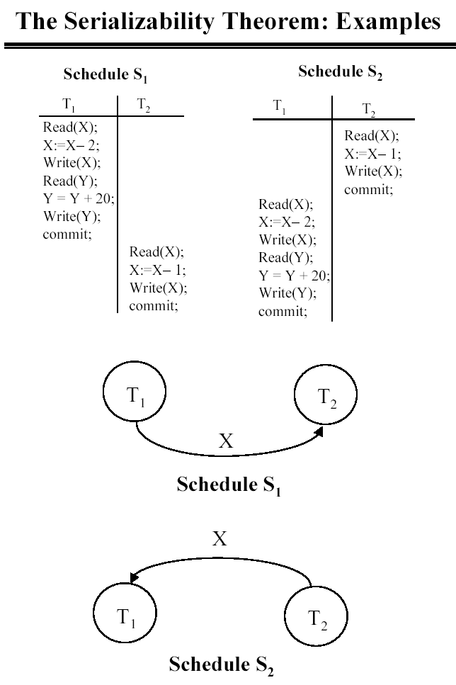

Slide 56
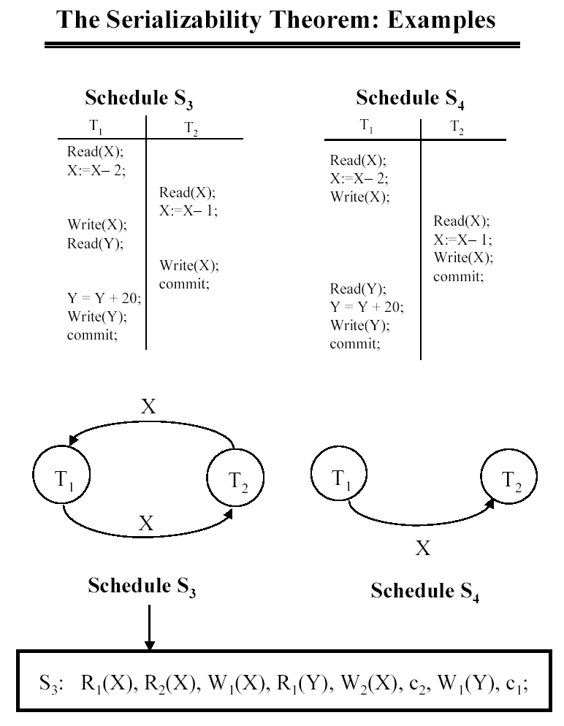

Slide 57
View equivalence: A less restrictive definition of equivalence of schedules (same set of transactions and same set of operations in the transactions)
View serializability: definition of serializability based on view equivalence. A schedule is view serializable if it is view equivalent to a serial schedule.
Two schedules are said to be view equivalent if the following three conditions hold:
The same set of transactions participates in S and S’, and S and S’ include the same operations of those transactions.
For any operation Ri(X) of Ti in S, if the value of X read by the operation has been written by an operation Wj(X) of Tj (or if it is the original value of X before the schedule started), the same condition must hold for the value of X read by operation Ri(X) of Ti in S’.
If the operation Wk(Y) of Tk is the last operation to write item Y in S, then Wk(Y) of Tk must also be the last operation to write item Y in S’.

Slide 58
The idea behind view equivalence:
As long as each read operation of a transaction reads the result of the same write operation in both schedules, the write operations of each transaction must produce the same results.
“The view”: the read operations are said to see the the same view in both schedules.
Relationship between view and conflict serializability:
The two are same under constrained write assumption.
Constrained write assumption holds on all transactions in the schedule.
This condition states that any write operation w_{i}(X) in Ti is preceded by a
r_{i}(X) in T_{i} and that the value written by w_{i}(x) depends only the value of X read by r_{i}(X).
Therefore the new X = f(old X)

Slide 59
Constrained write assumption :The value of w_{i}(x) in Ti can be independent of its old value from the database.This is called blind write.
Consider the following schedule of three transactions
T1: r1(X), w1(X); T2: w2(X); and T3: w3(X):
Schedule Sa: r1(X); w2(X); w1(X); w3(X); c1; c2; c3;
In Sa, the operations w2(X) and w3(X) are blind writes, since T1 and T3 do not read the value of X.
Sa is view serializable, since it is view equivalent to the serial schedule T1, T2, T3. However, Sa is not conflict serializable, since it is not conflict equivalent to any serial schedule.
Note:Any conflict serializable is also view serializable but not vice versa.

